Slide 1

Phishing Awareness Training
Protecting Yourself from Online Threats
PRESENTED BY:
V.H.V.HARSHA VARDHAN
TO:
CODEALPHA team

Slide 2

What is Phishing?
A cyber attack that tricks users into revealing sensitive information.
Disguised as a trustworthy source (email, website, message).
Goal: Steal data like passwords, bank info, etc.

Slide 3
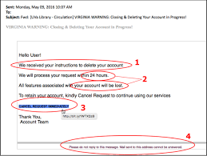
Recognizing Phishing Emails
Urgent or threatening language.
Unknown or spoofed senders.
Generic greetings like 'Dear User'.
Unexpected attachments or links.

Slide 4
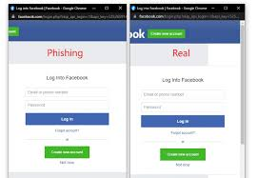
Spotting Fake Websites
Check for HTTPS and the correct domain.
Look for spelling errors or strange design.
Avoid entering credentials on unverified sites.

Slide 5
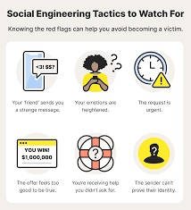
Social Engineering Tactics
Pretending to be someone trustworthy (IT, manager).
Creating urgency ("Act now!").
Emotional manipulation (fear, trust).

Slide 6
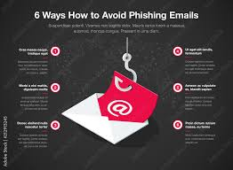
Best Practices & Tips
Use two-factor authentication.
Don’t click suspicious links.
Hover over links to inspect URLs.
Report suspicious emails.

Slide 7
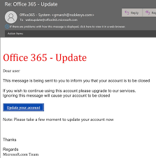
Real-World Examples
Email pretending to be from PayPal asking for login.
Fake call from 'bank support' requesting card number.
Link to a phishing login page that mimics a real site.

Slide 8
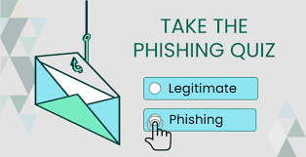
Quiz Example
Q: What should you do if an email says 'click this link to verify your account'?
A. Click quickly
B. Report it and contact the company directly
C. Forward to friends
Correct Answer: B

Slide 9
Summary
Stay alert to phishing signs.
Think before clicking.
When in doubt, report it!

Slide 10
Thank You
Let’s keep your data safe!
Any Questions?

